Slide 1
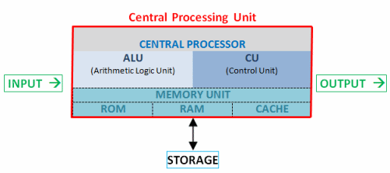
CPU Architecture
Lecture 2
Dhanusha Somawardhana
BSc(hons) it (slit), mba (uow), Reading Phd(BA) AeU

Slide 2
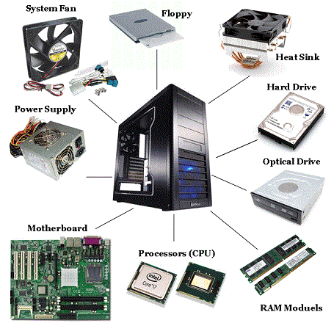
Chapter Overview
Components of the Motherboard
Registers
BUS
ALU
Processor and Coprocessor
DMA (Direct Memory Access)

Slide 3
Von Neumann Architecture
All computers share the same basic architecture, whether it be a multi-million dollar mainframe or a Palm Pilot.
All have memory, an I/O system, and arithmetic/logic unit, and a control unit.
This type of architecture is named Von Neumann architecture after the mathematician who conceived of the design.

Slide 4
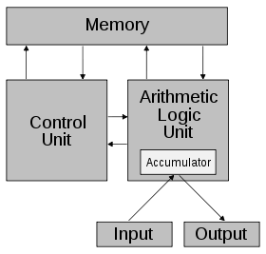
Von Neumann Architecture

Slide 5
Von Neumann Architecture
Von Neumann envisioned the structure of a computer system as being composed of the following components:
(1) arithmetic-logic unit (ALU)
this unit performs the computer's computational and logical functions
(2) memory
the computer's main, or fast, memory, such as random access memory (RAM)
(3) control unit
directs other components of the computer to perform certain actions
(4) input and output devices
main-machine interfaces; i.e.,

Slide 6
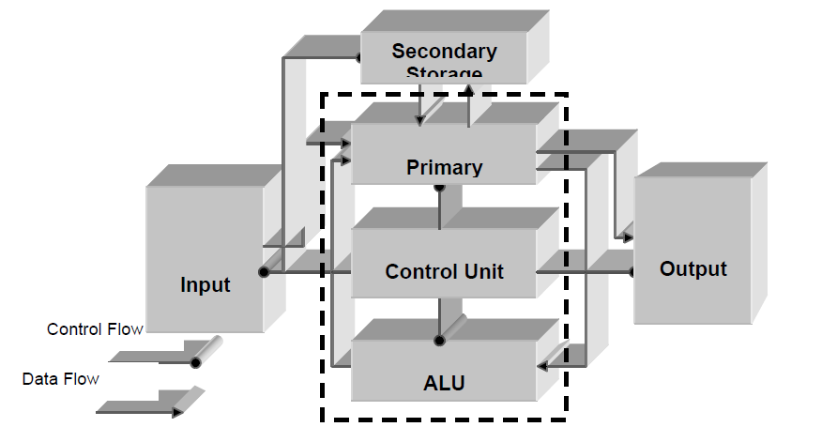
Components of CPU

Slide 7
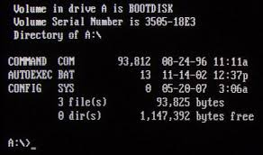
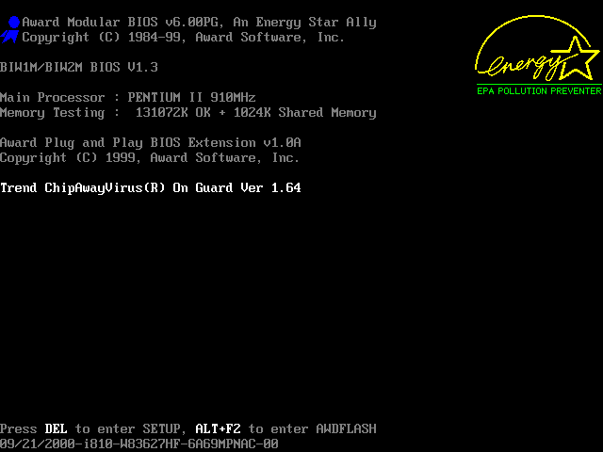
Booting
Execution of some pre-scheduled commands during the start up of a computer.
During the process of booting, the resident portion of the operating system is loaded Into the main memory.
Executing the autoexec.bat file after the operating system is loaded.
This contains a set of operating system commands such as commands to set the path, device drivers etc.

Slide 8
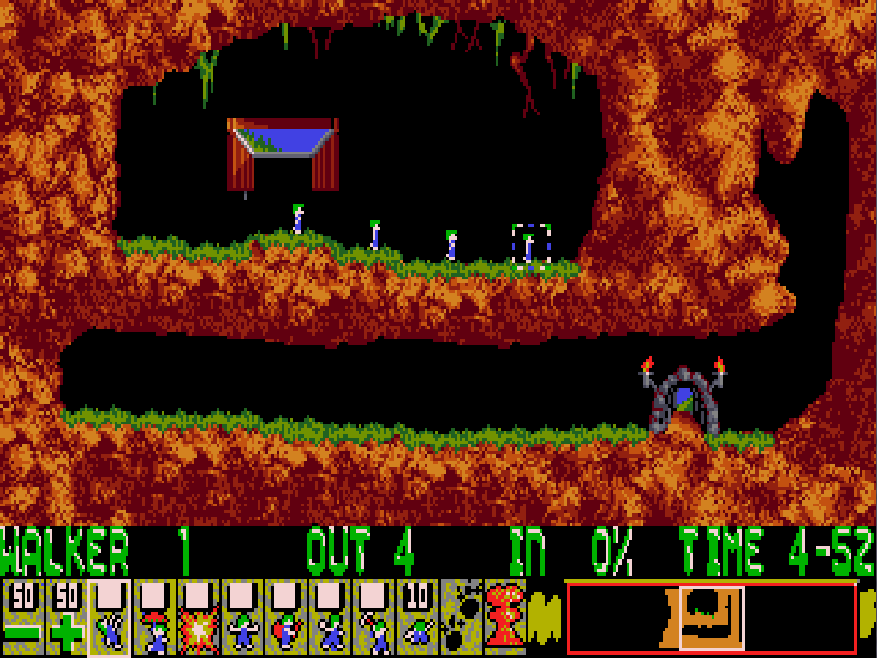
Microsoft Disk Operating System (DOS)
An operating system with a command-line interface used on personal computers.
Navigated by using MS-DOS commands.
MS-DOS originally written by Tim Paterson and introduced by Microsoft in August 1981 .
Two type of commands – directory commands and file commands

Slide 9
Mother-Board
Interconnects the PC components.
Divided into main 2 parts (Bus board and Processor board).
Bus Board - Has the slots for the adapters and the interfaces.
Processor Board – Responsible for the co-processor functions and transferring of the instructions

Slide 10
Cont.
The central component of the motherboard is the main processor.
The CPU is associated with a coprocessor for mathematical applications.
Houses a cache controller and a cache RAM to enhance the overall performance of the computer.
Houses other devices like main memory or RAM, the ROM BIOS, the DMA controller , timer, keyboard interface and bus slots.

Slide 11
Basic Components of Motherboard
Processor and Coprocessor – Performs extensive mathematical calculation with high accuracy.
A coprocessor is a special set of circuit s in a microprocessor chip that is designed to manipulate numbers or perform some other specialized function more quickly than the basic microprocessor circuits could perform the same task.
The RAM (Random Access Memory) - Temporarily store data
Bus –Address Bus and Data Bus (For data transferring)
Cache - smaller and faster memory locations in the mother board

Slide 12
Cont.
ROM - contains some programs and data that are required by the computer during power up.
BUS Slots - The slots into which the various buses in the system are connected.
DMS - transfer extensive amount of data between the secondary memory and the primary memory or vice versa.
Time - supply a clock signal based on which the CPU performs its operations and issues timer interrupts to update to internal clock and to refresh the contents of the RAM.

Slide 13
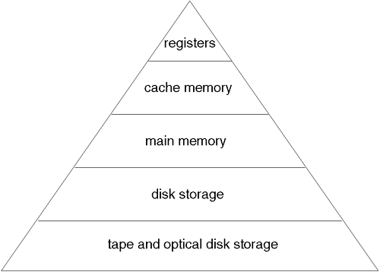
Memory Hierarchy

Slide 14
Registers
Small storage components that are used for a very fast access of data.
Directly access the hardware access them through the registers.
Registers have limited effect to the microprocessor.
Adding more registers make a program more efficient.

Slide 15
How registers work?
User instructs the application program to open a file.
This command is converted into a system call to the operating system.
The operating system in turn converts the command and accesses the BIOS to execute the user command.
The BIOS then accesses the corresponding hardware with the help of the corresponding register.
The BIOS converts the defined function call into a command sequence for the register concerned

Slide 16
Types of Registers
Instruction Pointer - Used to point to the next instruction that is to be fetched by the processor for execution.
Flag Register - Collection of a number of flags that are required by the processor for performing various operations.
Segment Registers - used by a processor in a segmented memory environment to point to a particular memory segment.

Slide 17
Cont.
Address Register - Used to store the address of the data that has to be either stored in the main memory or fetched from the main memory.
Data Register - Used to hold the data that has to be transferred between two devices.
Pointer and Index Register - Used by the ALU to perform arithmetic and logical functions.

Slide 18
Cont.
Scratch Pad Registers - Used by the ALU for storing temporary values and intermediate results. These registers are not accessible by any instruction.
Accumulator - Register that is used by the ALU to temporarily hold the results of a previous operation.

Slide 19
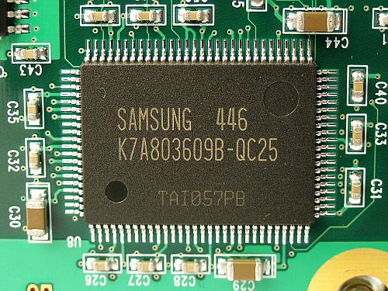
Cache
Compared to the conventional RAM chips, the cache is smaller and faster.
Access time is much lower than conventional RAM.
Cache holds the data that are frequently required by the processor.

Slide 20
How Cache Works?
When the processor requests some data, the cache controller first checks whether the data is present in the cache.
If it is present, then it is immediately made available to the processor.
If the data is not held in the cache memory, then the cache reads the main memory and simultaneously transfers the read data to the processor.
When the processor wants to write to the main memory, it writes onto the cache memory at high speed.
The cache controller then writes the data back to the main memory later.

Slide 21
BUS
Buses are a set of parallel electrical conducting lines that connect various components on the motherboard.
Combined in different ways to suit different functions and each combination is given a different name.
Provide electrical interconnection between the processor components and the interface device used with peripheral equipment.

Slide 22
Cont.
The width of a bus - The number of electrical lines that make up the bus (number of bits it can carry at one instance of time).
16 – bit - 16 electrical lines that combine together to form the bus.
Transfer the data between the processor and peripherals or between different peripherals.
The bus width should match the data path width of the microprocessor.
During data transfer, the entire word may be transferred in one exchange - improve the overall performance of the processor.

Slide 23
Cont.
Adding more number of data lines on to the bus, adds complexity to the circuits in the memory as well as the processor.

Slide 24
Arbitration and Bus-Mastering
A bus that is connected directly to the processor data and address lines are called local bus.
Components are connected via the PC Bus.
The components connected to the bus are in direct contact and control of the processor.
Need not always control the operation of the bus.
The arbitrated expansion bus - design, the processor is not in full control of the bus but it is connected to the bus just as any other component. The control of the bus is handed over to specialized circuits called the bus controller

Slide 25
Dual Bus Architecture
Single Bus has devastating effects on the performance of the computer.
Dual Bus- one for memory and the other for the I/O expansion bus.
Compaq Computer Corporation was the first company to introduced dual-bus PC

Slide 26
Thank You…!!!

